Slide 1
Unit 8 : Research Trends in Data Warehousing and Data Mining
Lecturer : Bijay Mishra

Slide 2
Data Mining Systems Products and Research Prototypes
As a young discipline, data mining has a relatively short history and are constantly evolving-new data mining systems appear on the market every year; new functions, features, and visualization tools are added to existing systems on a constant basis; and efforts toward the standardization of data mining language have only just begun.

Slide 3
How to Choose a Data Mining System?
Commercial data mining systems have little in common
Different data mining functionality or methodology
May even work with completely different kinds of data sets
Need multiple dimensional view in selection
Data types: relational, transactional, text, time sequence, spatial?
System issues
running on only one or on several operating systems?
a client/server architecture?
Provide Web-based interfaces and allow XML data as input and/or output?

Slide 4
Data sources
ASCII text files, multiple relational data sources
support ODBC connections (OLE DB, JDBC)?
Data mining functions and methodologies
One vs. multiple data mining functions
One vs. variety of methods per function
More data mining functions and methods per function provide the user with greater flexibility and analysis power
Coupling with Database and/or data warehouse systems
Four forms of coupling: no coupling, loose coupling, semitight coupling, and tight coupling
Ideally, a data mining system should be tightly coupled with a database system

Slide 5
Scalability
Row (or database size) scalability
Column (or dimension) scalability
Curse of dimensionality: it is much more challenging to make a system column scalable that row scalable
Visualization tools
“A picture is worth a thousand words”
Visualization categories: data visualization, mining result visualization, mining process visualization, and visual data mining
Data mining query language and graphical user interface
Easy-to-use and high-quality graphical user interface
Essential for user-guided, highly interactive data mining

Slide 6



Examples of Data Mining Systems

Slide 7
Examples of Data Mining Systems
Microsoft SQL Server 2005
Integrate DB and OLAP with mining
Support OLEDB for DM standard
IBM Intelligent Miner
Intelligent Miner is an IBM data-mining product
A wide range of data mining algorithms
Scalable mining algorithms
Toolkits: neural network algorithms, statistical methods, data preparation, and data visualization tools
Tight integration with IBM's DB2 relational database system
SAS Enterprise Miner
SAS Institute Inc. developed Enterprise Miner
A variety of statistical analysis tools
Data warehouse tools and multiple data mining algorithms

Slide 8
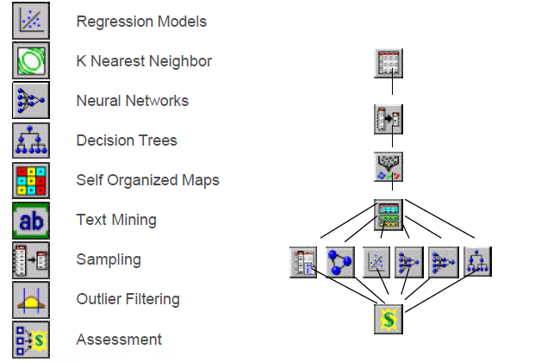
Enterprise Miner Capabilities

Slide 9
SGI MineSet
Silicon Graphics Inc. (SGI) developed MineSet
Multiple data mining algorithms and advanced statistics
Advanced visualization tools
DBMiner
DBMiner Technology Inc developed DBMiner.
It provides multiple data mining algorithms including discovery-driven OLAP analysis, association, classification, and clustering
SPSS Clementine
Integral Solutions Ltd. (ISL) developed Clementine
Clementine has been acquired by SPSS Inc.
An integrated data mining development environment for end-users and developers
Multiple data mining algorithms and visualization tools including rule induction, neural nets, classification, and visualization tools

Slide 10
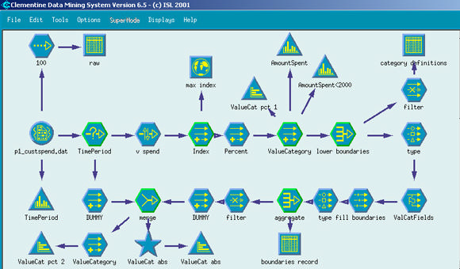
SPSS Clementine

Slide 11
Theoretical Foundations of Data Mining
Data reduction
The basis of data mining is to reduce the data representation
Trades accuracy for speed in response
Data compression
The basis of data mining is to compress the given data by encoding in terms of bits, association rules, decision trees, clusters, etc.
Pattern discovery
The basis of data mining is to discover patterns occurring in the database, such as associations, classification models, sequential patterns, etc.

Slide 12
Probability theory
The basis of data mining is to discover joint probability distributions of random variables
Microeconomic view
A view of utility: the task of data mining is finding patterns that are interesting only to the extent in that they can be used in the decision-making process of some enterprise
Inductive databases
Data mining is the problem of performing inductive logic on databases,
The task is to query the data and the theory (i.e., patterns) of the database
Popular among many researchers in database systems

Slide 13
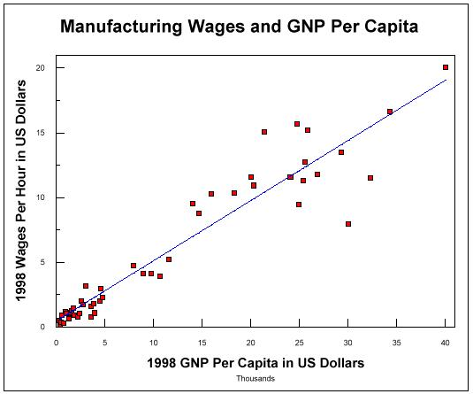
Statistical Data Mining
There are many well-established statistical techniques for data analysis, particularly for numeric data
applied extensively to data from scientific experiments and data from economics and the social sciences
Regression
predict the value of a response (dependent) variable from one or more predictor (independent) variables where the variables are numeric
forms of regression: linear, multiple, weighted, polynomial, nonparametric, and robust

Slide 14
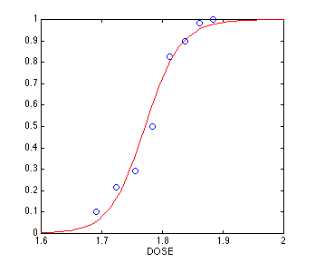
Generalized linear models
allow a categorical response variable (or some transformation of it) to be related to a set of predictor variables
similar to the modeling of a numeric response variable using linear regression
include logistic regression and Poisson regression
Mixed-effect models
For analyzing grouped data, i.e. data that can be classified according to one or more grouping variables
Typically describe relationships between a response variable and some covariates in data grouped according to one or more factors

Slide 15
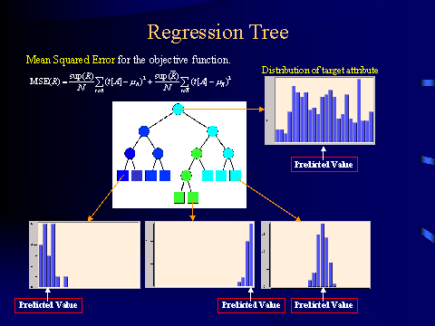
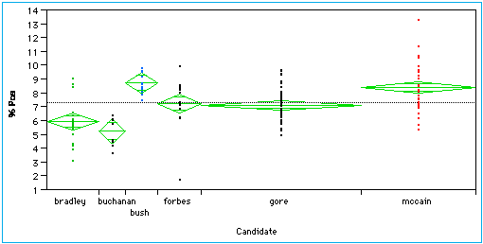
Regression trees
Binary trees used for classification and prediction
Similar to decision trees:Tests are performed at the internal nodes
In a regression tree the mean of the objective attribute is computed and used as the predicted value
Analysis of variance
Analyze experimental data for two or more populations described by a numeric response variable and one or more categorical variables (factors)

Slide 16
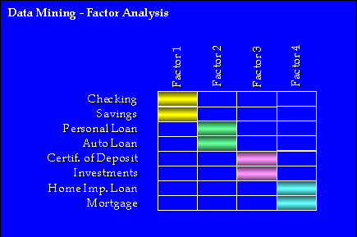
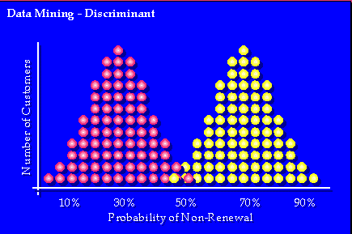
www.spss.com/datamine/factor.htm
Factor analysis
determine which variables are combined to generate a given factor
e.g., for many psychiatric data, one can indirectly measure other quantities (such as test scores) that reflect the factor of interest
Discriminant analysis
predict a categorical response variable, commonly used in social science
Attempts to determine several discriminant functions (linear combinations of the independent variables) that discriminate among the groups defined by the response variable

Slide 17
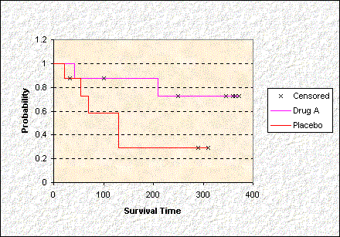
Time series:
Many methods such as auto regression, ARIMA (Autoregressive integrated moving-average modeling), long memory time-series modeling
Quality control:
Displays group summary charts
Survival analysis
Predicts the probability that a patient undergoing a medical treatment would survive at least to time t (life span prediction)

Slide 18
Visual and Audio Data Mining
Visualization: use of computer graphics to create visual images which aid in the understanding of complex, often massive representations of data
Visual Data Mining: the process of discovering implicit but useful knowledge from large data sets using visualization techniques
Computer Graphics
Multimedia Systems
Pattern Recognition
High Performance Computing
Human Computer Interfaces

Slide 19
Purpose of Visualization
Gain insight into an information space by mapping data onto graphical primitives
Provide qualitative overview of large data sets
Search for patterns, trends, structure, irregularities, relationships among data.
Help find interesting regions and suitable parameters for further quantitative analysis.
Provide a visual proof of computer representations derived

Slide 20
Integration of visualization and data mining
data visualization
data mining result visualization
data mining process visualization
interactive visual data mining
Data visualization
Data in a database or data warehouse can be viewed
at different levels of granularity or abstraction
as different combinations of attributes or dimensions
Data can be presented in various visual forms

Slide 21
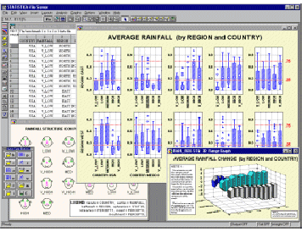
Boxplots from Statsoft: Multiple Variable Combinations

Slide 22
Data Mining Result Visualization
Presentation of the results or knowledge obtained from data mining in visual forms
Examples
Scatter plots and boxplots (obtained from descriptive data mining)
Decision trees
Association rules
Clusters
Outliers
Generalized rules

Slide 23
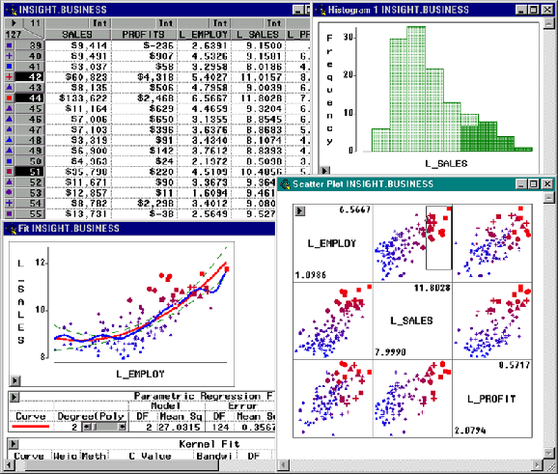
Visualization of Data Mining Results in SAS Enterprise Miner: Scatter Plots

Slide 24
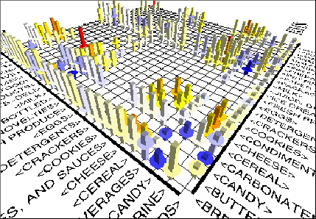
Visualization of Association Rules in SGI/MineSet 3.0

Slide 25
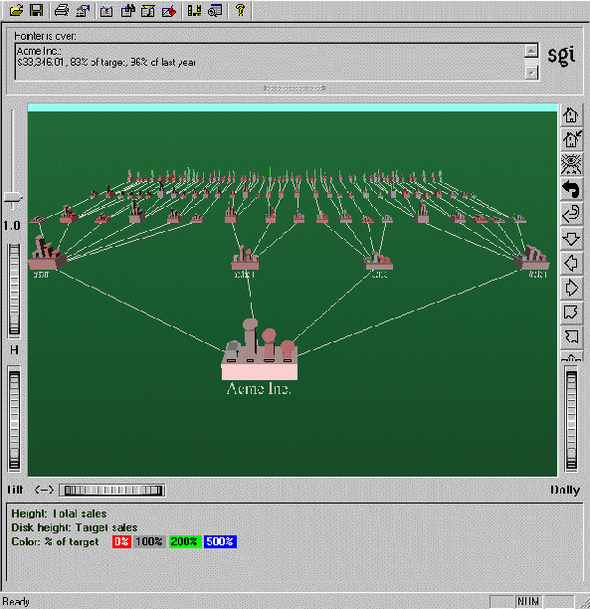
Visualization of a Decision Tree in SGI/MineSet 3.0

Slide 26
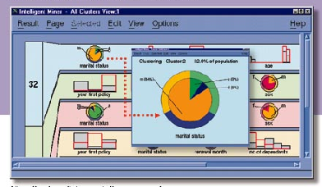
Visualization of Cluster Grouping in IBM Intelligent Miner

Slide 27
Data Mining Process Visualization
Presentation of the various processes of data mining in visual forms so that users can see
Data extraction process
Where the data is extracted
How the data is cleaned, integrated, preprocessed, and mined
Method selected for data mining
Where the results are stored
How they may be viewed

Slide 28
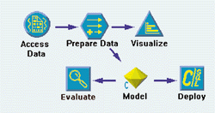
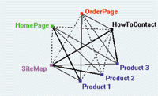
Visualization of Data Mining Processes by Clementine
See your solution discovery process clearly
Understand variations with visualized data

Slide 29
Interactive Visual Data Mining
Using visualization tools in the data mining process to help users make smart data mining decisions
Example
Display the data distribution in a set of attributes using colored sectors or columns (depending on whether the whole space is represented by either a circle or a set of columns)
Use the display to which sector should first be selected for classification and where a good split point for this sector may be

Slide 30
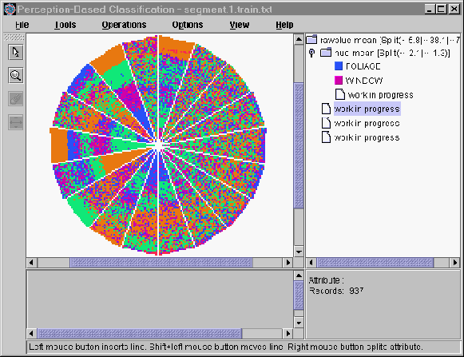
Interactive Visual Mining by Perception-Based Classification (PBC)

Slide 31
Audio Data Mining
Uses audio signals to indicate the patterns of data or the features of data mining results
An interesting alternative to visual mining
An inverse task of mining audio (such as music) databases which is to find patterns from audio data
Visual data mining may disclose interesting patterns using graphical displays, but requires users to concentrate on watching patterns
Instead, transform patterns into sound and music and listen to pitches, rhythms, tune, and melody in order to identify anything interesting or unusual

Slide 32
Data Mining and Collaborative Filtering

Slide 33
Social Impact of Data Mining
Is Data Mining a Hype or Will It Be Persistent?
Data mining is a technology
Technological life cycle
Innovators
Early adopters
Chasm
Early majority
Late majority
Laggards

Slide 34
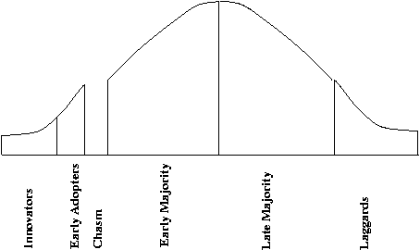
Life Cycle of Technology Adoption
Data mining is at Chasm!?
Existing data mining systems are too generic
Need business-specific data mining solutions and smooth integration of business logic with data mining functions

Slide 35
Social Impacts: Threat to Privacy
Is data mining a threat to privacy and data security?
“Big Brother”, “Big Banker”, and “Big Business” are carefully watching you
Profiling information is collected every time
You use your credit card, debit card, supermarket loyalty card, or frequent flyer card, or apply for any of the above
You surf the Web, reply to an Internet newsgroup, subscribe to a magazine, rent a video, join a club, fill out a contest entry form,
You pay for prescription drugs, or present you medical care number when visiting the doctor
Collection of personal data may be beneficial for companies and consumers, there is also potential for misuse

Slide 36
Protect Privacy and Data Security
Fair information practices
International guidelines for data privacy protection
Cover aspects relating to data collection, purpose, use, quality, openness, individual participation, and accountability
Purpose specification and use limitation
Openness: Individuals have the right to know what information is collected about them, who has access to the data, and how the data are being used
Develop and use data security-enhancing techniques
Blind signatures
Biometric encryption
Anonymous databases

Slide 37
Trends in Data Mining
Application exploration
development of application-specific data mining system
Invisible data mining (mining as built-in function)
Scalable data mining methods
Constraint-based mining: use of constraints to guide data mining systems in their search for interesting patterns
Integration of data mining with database systems, data warehouse systems, and Web database systems
Invisible data mining

Slide 38
Standardization of data mining language
A standard will facilitate systematic development, improve interoperability, and promote the education and use of data mining systems in industry and society
Visual data mining
New methods for mining complex types of data
More research is required towards the integration of data mining methods with existing data analysis techniques for the complex types of data
Web mining
Privacy protection and information security in data mining

Slide 39
Questions?

Slide 40
References
Petrushin, Valery A: Introduction into Multimedia Data Mining and Knowledge Discovery. Edited by Valery A Petrushin and Latifur Khan. London: Springer-Verlag, 2007. P. 3-13.J.
J. Han and M. Kamber. Data Mining: Concepts and Techniques. Morgan Kaufmann, 2000.
W. Cleveland. Visualizing Data. Hobart Press, Summit NJ, 1993.
J. L. Devore. Probability and Statistics for Engineering and the Science, 4th ed. Duxbury Press, 1995.
G. Piatetsky-Shapiro and W. J. Frawley. Knowledge Discovery in Databases. AAAI/MIT Press, 1991.

Slide 41
End of Unit 8

Slide 42
Thank you !!!

